Slide 1




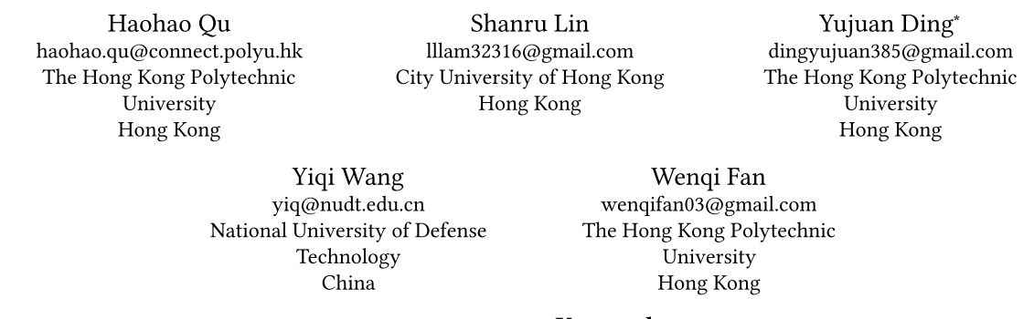





ATAI
Advanced Technique of Artificial Intelligence
ATAI
ChongqingUniversity _{AdvancedTechniqueof}
of Technology Artificial Intelligence
Chongqing University of
Technology
Chongqing University ^{ATAI}
_{of Technology} Advanced Techniqueof
Artificial Intelligence
Chongqing University of Technology
Chongqing University of Technology
Diffusion Generative Recommendation with Continuous Tokens
—— WWW2026
2026.03.08 • ChongQing
Reported by Jing Li
1

Slide 2
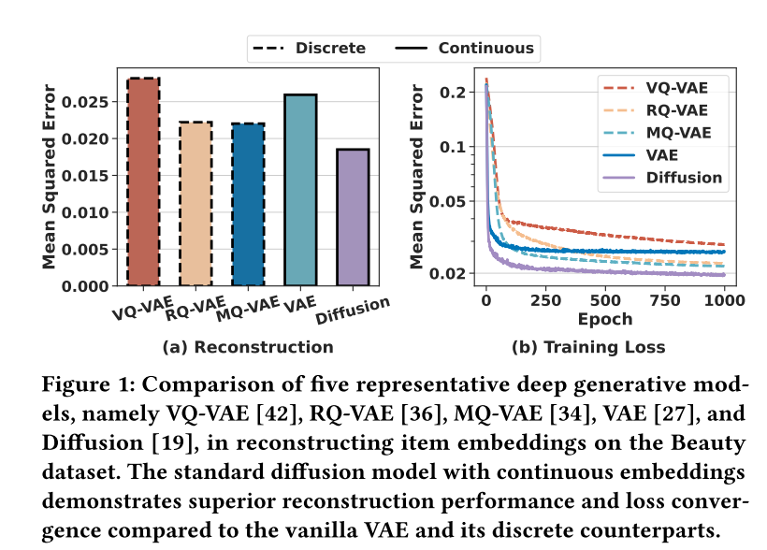
ATAI
Advanced Technique of Artificial Intelligence
ATAI
ChongqingUniversity _{AdvancedTechniqueof}
of Technology Artificial Intelligence
Chongqing University of
Technology
Chongqing University ^{ATAI}
_{of Technology} Advanced Techniqueof
Artificial Intelligence
Chongqing University of Technology
Chongqing University of Technology
Motivation
Most LLM-based recommender systems inherit the discrete-token paradigm of language models, so they often quantize continuous user/item representations into discrete codes (VQ-VAE/RQ-VAE/MQ-VAE). However, quantization is inherently lossy , which can hinder representation learning and recommendation performance.
Meanwhile, some approaches only inject continuous vectors via simple projection layers at the input side while keeping the LLM’s output generator in the discrete vocabulary, creating a discrete–continuous gap and weakening model unification.

Slide 3
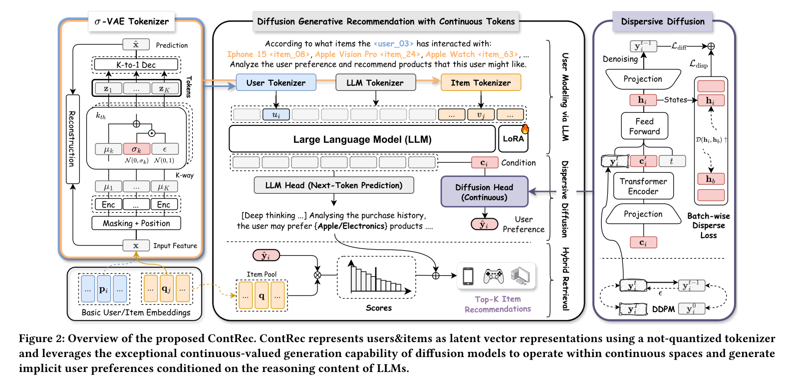
ATAI
Advanced Technique of Artificial Intelligence
ATAI
ChongqingUniversity _{AdvancedTechniqueof}
of Technology Artificial Intelligence
Chongqing University of
Technology
Chongqing University ^{ATAI}
_{of Technology} Advanced Techniqueof
Artificial Intelligence
Chongqing University of Technology
Chongqing University of Technology

Slide 4

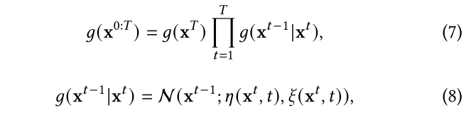
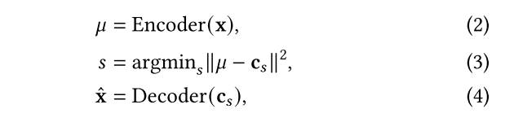
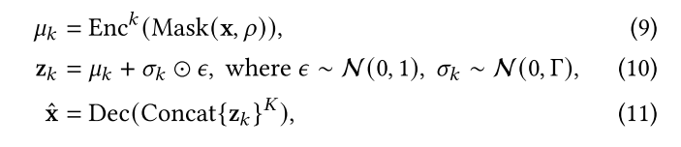
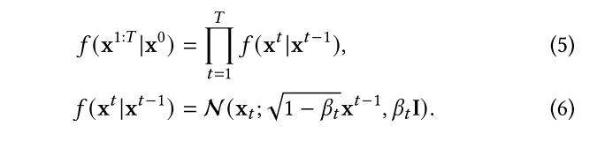
ATAI
Advanced Technique of Artificial Intelligence
ATAI
ChongqingUniversity _{AdvancedTechniqueof}
of Technology Artificial Intelligence
Chongqing University of
Technology
Chongqing University ^{ATAI}
_{of Technology} Advanced Techniqueof
Artificial Intelligence
Chongqing University of Technology
Chongqing University of Technology

Slide 5


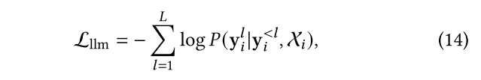

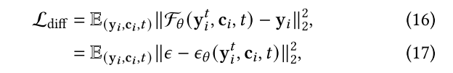
ATAI
Advanced Technique of Artificial Intelligence
ATAI
ChongqingUniversity _{AdvancedTechniqueof}
of Technology Artificial Intelligence
Chongqing University of
Technology
Chongqing University ^{ATAI}
_{of Technology} Advanced Techniqueof
Artificial Intelligence
Chongqing University of Technology
Chongqing University of Technology
Method

Slide 6




ATAI
Advanced Technique of Artificial Intelligence
ATAI
ChongqingUniversity _{AdvancedTechniqueof}
of Technology Artificial Intelligence
Chongqing University of
Technology
Chongqing University ^{ATAI}
_{of Technology} Advanced Techniqueof
Artificial Intelligence
Method
Chongqing University of Technology
Chongqing University of Technology

Slide 7
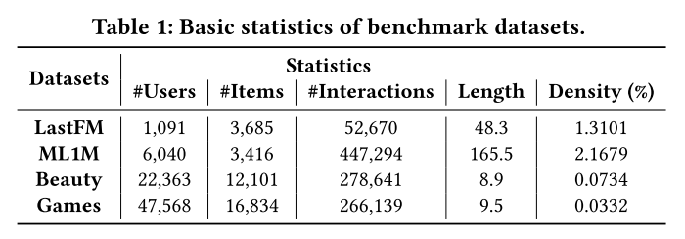
ATAI
Advanced Technique of Artificial Intelligence
ATAI
ChongqingUniversity _{AdvancedTechniqueof}
of Technology Artificial Intelligence
Chongqing University of
Technology
Chongqing University ^{ATAI}
_{of Technology} Advanced Techniqueof
Artificial Intelligence
Method
Chongqing University of Technology
Chongqing University of Technology

Slide 8
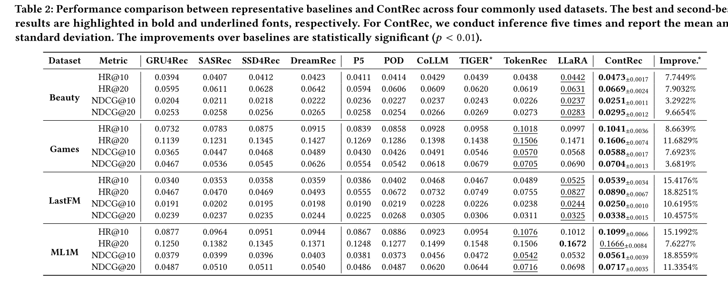
ATAI
Advanced Technique of Artificial Intelligence
ATAI
ChongqingUniversity _{AdvancedTechniqueof}
of Technology Artificial Intelligence
Chongqing University of
Technology
Chongqing University ^{ATAI}
_{of Technology} Advanced Techniqueof
Artificial Intelligence
Method
Chongqing University of Technology
Chongqing University of Technology

Slide 9
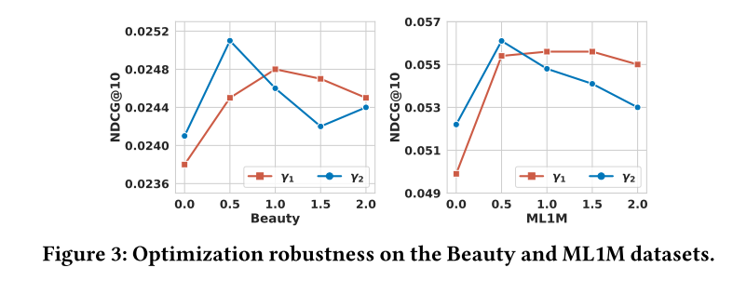
ATAI
Advanced Technique of Artificial Intelligence
ATAI
ChongqingUniversity _{AdvancedTechniqueof}
of Technology Artificial Intelligence
Chongqing University of
Technology
Chongqing University ^{ATAI}
_{of Technology} Advanced Techniqueof
Artificial Intelligence
Method
Chongqing University of Technology
Chongqing University of Technology

Slide 10
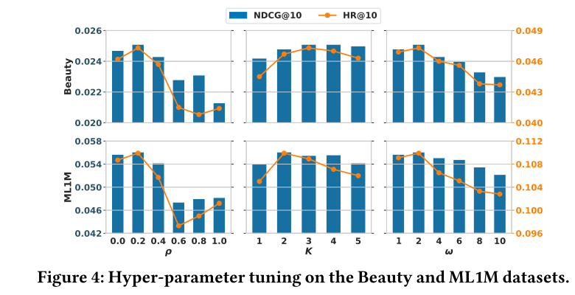
ATAI
Advanced Technique of Artificial Intelligence
ATAI
ChongqingUniversity _{AdvancedTechniqueof}
of Technology Artificial Intelligence
Chongqing University of
Technology
Chongqing University ^{ATAI}
_{of Technology} Advanced Techniqueof
Artificial Intelligence
Method
Chongqing University of Technology
Chongqing University of Technology

Slide 11
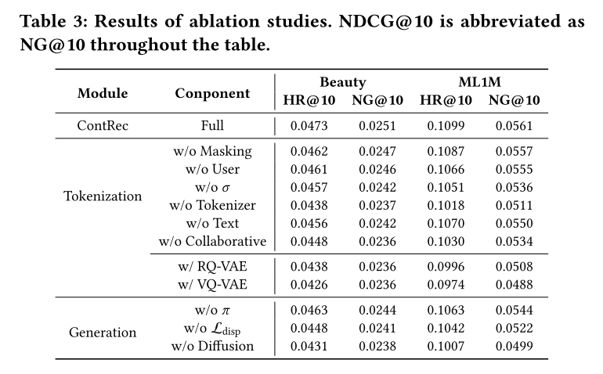
ATAI
Advanced Technique of Artificial Intelligence
ATAI
ChongqingUniversity _{AdvancedTechniqueof}
of Technology Artificial Intelligence
Chongqing University of
Technology
Chongqing University ^{ATAI}
_{of Technology} Advanced Techniqueof
Artificial Intelligence
Chongqing University of Technology
Experiments
Chongqing University of Technology

Slide 12
ATAI
Advanced Technique of Artificial Intelligence
ATAI
ChongqingUniversity _{AdvancedTechniqueof}
of Technology Artificial Intelligence
Chongqing University of
Technology
Chongqing University ^{ATAI}
_{of Technology} Advanced Techniqueof
Artificial Intelligence
Chongqing University of Technology
Chongqing University of Technology
Thanks!

